Slide 1
Aerial Object Detection
HyeongJun Kwon
2019-2

Slide 2
Overall tree
Entire detector
One-stage detector
Two-stage detector
RPN-based
AF-based

Slide 3
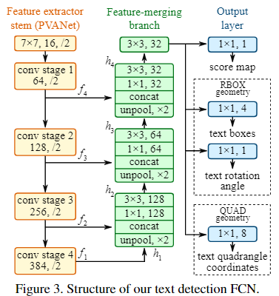
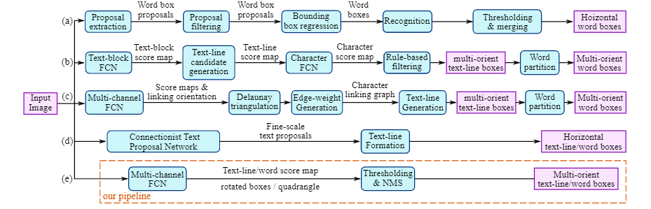
EAST an Efficient and Accurate Scene Text Detector
Overall framework

Slide 4
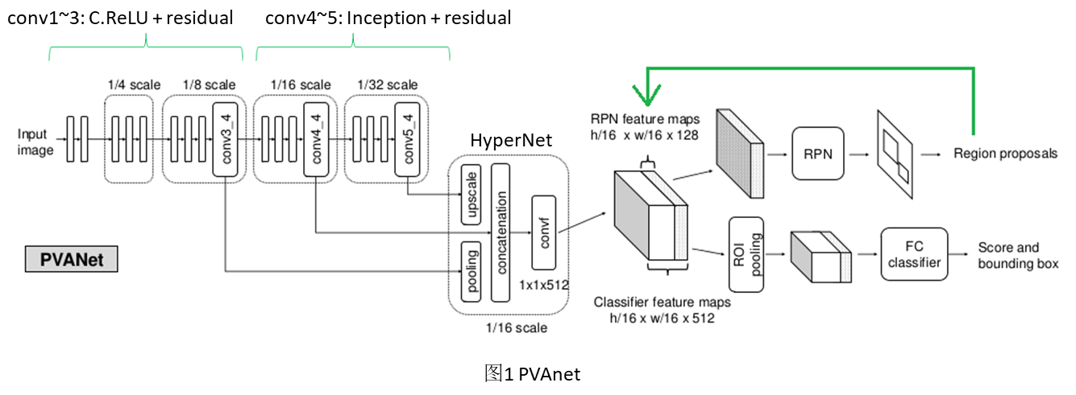
EAST an Efficient and Accurate Scene Text Detector
PVA-net

Slide 5
EAST an Efficient and Accurate Scene Text Detector
U-shape
input
output
For reduce computation cost, using U-shape not using HyperNet in PVANet that merge all feature maps
conv1
merging3
conv2
merging2
conv3
merging1
conv3

Slide 6
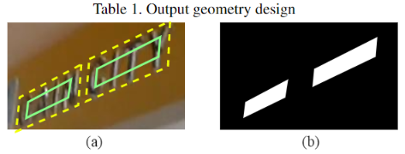


EAST an Efficient and Accurate Scene Text Detector
Score map
Score map generation eq
$$r_{i}=min(D\left(p_{i}, p_{\left(i mod 4\right)+1}\right),$$
$$D\left(p_{i}, p_{\left(\left(i+2\right) mod 4\right)+1}\right)$$
we shrink it by moving its two endpoints inward along the edge by$0.3r_{i} and 0.3r_{\left(i mod 4\right)+1}$espectively.

Slide 7



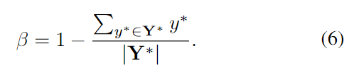

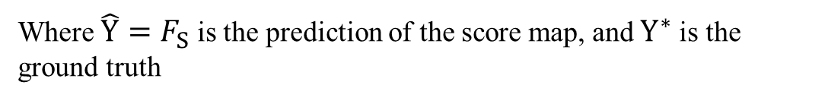
EAST an Efficient and Accurate Scene Text Detector
Score map
$$L=L_{s}+λ_{g}L_{g}$$
$L_{s}$ : loss for score map
$L_{g}$ : loss for geometry
RBOX: $L_{g}=L_{AABB}+λ_{θ}L_{θ}$
Where $\hat{Y}=F_{S}$ is the prediction of the score map, and $Y^{∗}$is the ground truth

Slide 8
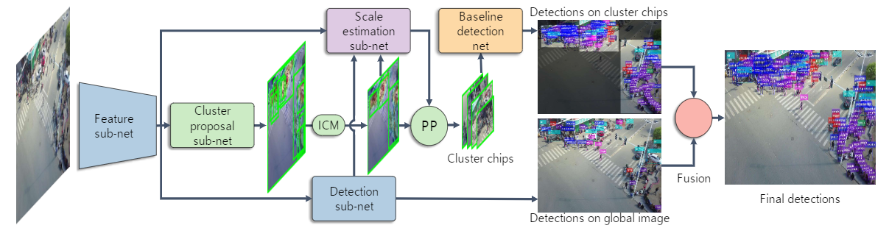
Clustered Object Detection in Aerial Images
Overall framework

Slide 9
Clustered Object Detection in Aerial Images

Slide 10
Clustered Object Detection in Aerial Images

Slide 11
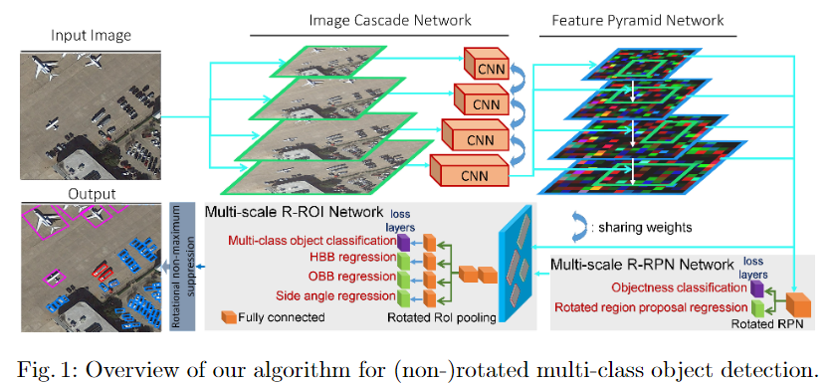
Towards Multi-class Object Detection in Unconstrained Remote Sensing Imagery
Overall framework

Slide 12
Towards Multi-class Object Detection in Unconstrained Remote Sensing Imagery
Main Contributions :
1. new joint image cascade and feature pyramid network(ICN and FPN)
2. design a DIN module as a domain adaptation module
3. new loss function to shape rectangles by constraining the angles between the edges to 90 degrees

Slide 13
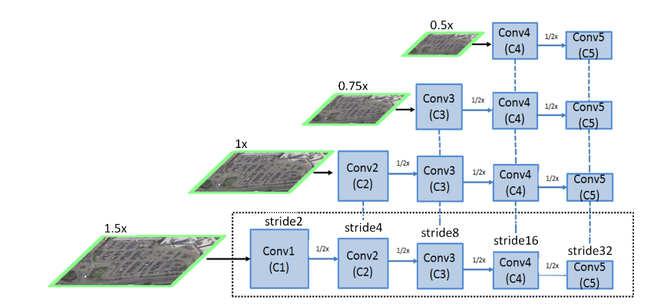
Towards Multi-class Object Detection in Unconstrained Remote Sensing Imagery
ICN, FPN and Deformable Inception Subnetworks
Appropriate weights sharing
Resize image size by bilinear interpolation
ICN
The low-level semantic feature from high resolution
The high-level semantic feature from low-level resolution

Slide 14
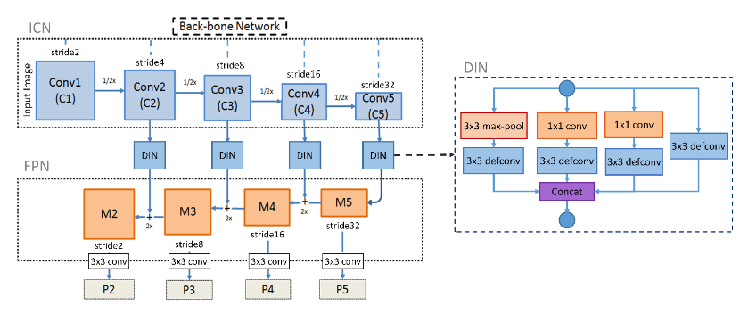
Towards Multi-class Object Detection in Unconstrained Remote Sensing Imagery
ICN, FPN and Deformable Inception Subnetworks

Slide 15
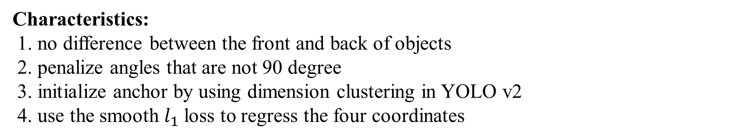
Towards Multi-class Object Detection in Unconstrained Remote Sensing Imagery
R-RoI & R-RPN
Characteristics:
1. no difference between the front and back of objects
2. penalize angles that are not 90 degree
3. initialize anchor by using dimension clustering in YOLO v2
4. use the smooth $l_{1}$loss to regress the four coordinates

Slide 16

Towards Multi-class Object Detection in Unconstrained Remote Sensing Imagery
Objective

Slide 17
Arbitrary-Oriented Object Detection with Circular Smooth Label

Slide 18
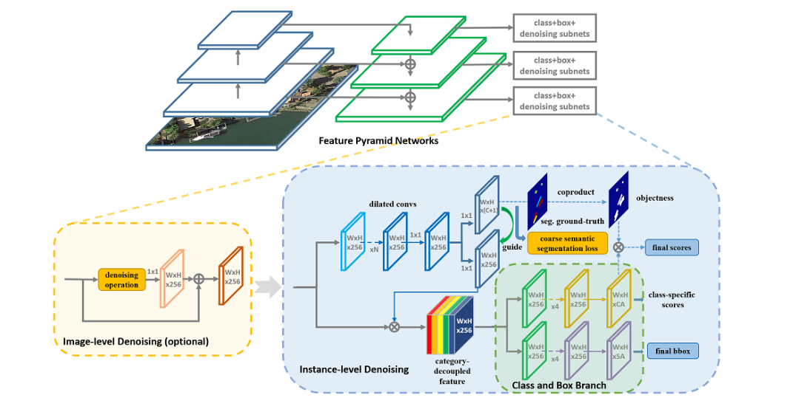
SCRDet++: Detecting Small, Cluttered and Rotated Objects via Instance-Level Feature Denoising and Rotation Loss Smoothing
Overall framework

Slide 19
SCRDet++: Detecting Small, Cluttered and Rotated Objects via Instance-Level Feature Denoising and Rotation Loss Smoothing
Overall framework

Slide 20
SCRDet++: Detecting Small, Cluttered and Rotated Objects via Instance-Level Feature Denoising and Rotation Loss Smoothing
Overall framework

Slide 21
SCRDet++: Detecting Small, Cluttered and Rotated Objects via Instance-Level Feature Denoising and Rotation Loss Smoothing
Overall framework

Slide 22
SCRDet++: Detecting Small, Cluttered and Rotated Objects via Instance-Level Feature Denoising and Rotation Loss Smoothing
Overall framework

Slide 23
SCRDet++: Detecting Small, Cluttered and Rotated Objects via Instance-Level Feature Denoising and Rotation Loss Smoothing
Overall framework

Slide 24
Adaptive Period Embedding for Representing

